Slide 1
Project Vozilo
Group Members:
Anas Yasin 16K-3822
Mudassir Latif 16K-3811
Adil Ayub 16K-3834

Slide 2
Overview
The project deals with today’s parking problems efficiently by utilizing a clear database and managing it through different aspects. Following project can record,store and manage incoming and outgoing vehicles from the parking lot. Also it makes sure security by checking CPLC status of incoming vehicle by using authenticate government websites and deciding whether to inform user or not about the CPLC status of vehicle. It does so by efficiently recognizing license plate of the car and converting it into a valid string using machine learning. After that it inserts fetched data into database along with some other credentials which are helpful to manage today’s huge parking lots, organization’s parking.

Slide 3
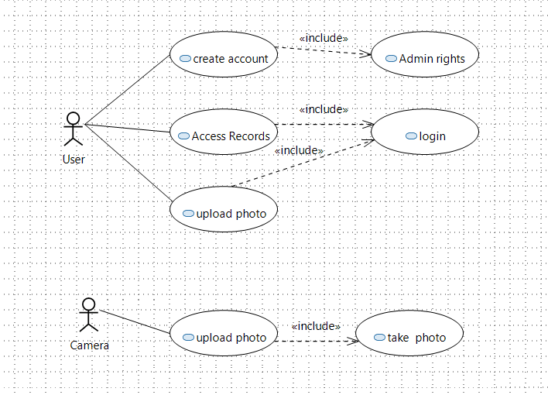
Use Case Diagram
*Upload Photo means upload photo for web scarping.

Slide 4
Work Division
Name | Work
Anas Yasin | Insert Queries
 | OCR and Webcam Module
Mudassir Latif | Table Create Queries
 | GUI Module
Adil Ayub | Selection Queries
 | Web-Scarping Module

Slide 5


